Slide 1
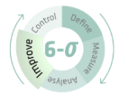
MS491-XVI
Lean Six Sigma
Analyse Phase
Discovering the Drivers of Deployment Delays (LT vs. HT Focus)
Project: Optimising EV Charging Station Deployment
Team 1
MS491-XVI · Analyse Phase Presentation
D M A I C

Slide 2
Days
PROJECT OVERVIEW — Measure Phase Recap
105+
85
Days
4
Key Variables
Avg Setup Cycle Time (Y)
Non-Value-Added Waiting (Muda)
Evaluated Bottlenecks (x₂ to x₄)
Project Objective
Establish a robust baseline performance of the current EV charging station setup process to identify root causes of severe cycle-time delays, and develop data-driven recommendations to stabilize and reduce deployment time.
Key Baseline Insights
DISCOM Delays (x₂):
A severe lack of upfront grid-capacity analysis frequently forces 90-day High Tension (HT) transformer augmentations, rather than utilising existing 30-day Low Tension (LT) connections.
Municipal Friction (x₄):
While physical civil work takes only 12 days, SLA "blindspots" in local municipal NOCs (Fire, Parking, Right-of-Way) cause highly variable, unpredictable administrative wait times.
Extreme Process Variation:
National setup capability is completely unstandardized. Cycle times vary widely geographically (e.g., streamlined in Gujarat under GERC rules vs. severe delays in Karnataka and UP).
Data Sources: NITI Aayog EV Handbook | Observer Research Foundation (ORF) | Primary Gemba Interview: EV Fleet Operator | Scope: National EV Infrastructure

Slide 3
ANALYZE PHASE & STAKEHOLDER EMPHASIS
What is the Analyse Phase?
The Strategic Focus: Narrowing our x's
The Analyse Phase is the 'A' in the DMAIC roadmap. It transforms raw baseline data collected in the Measure phase into actionable insights. The objective is to discover, mathematically verify, and prioritise the root causes (x's) driving process defects, bureaucratic inefficiencies, and extreme cycle-time variation (Y).
Based on this stakeholder directive and our initial data stratification, this analysis will strictly focus on mathematically validating our two most severe bottlenecks:
x₂ — DISCOM Grid Connections:
Stakeholder Emphasis: The "Gemba" Insight
The structural delays caused by High Tension (HT) transformer upgrades versus existing Low Tension (LT) availability.
To validate baseline assumptions, our team conducted a primary stakeholder interview with an active EV Fleet Operator and Charging Station Provider. By going to the source ("Gemba"), we uncovered a critical operational reality:
x₄ — Municipal Approvals:
The unstandardized wait times (Muda) caused by fragmented local governance and missing SLAs.
The Civil Work Fallacy:
Physical site preparation and hardware installation occur concurrently during administrative waiting periods. Physical constraints are NOT the bottleneck.
The "Handoff" Waste:
The operator explicitly cited multi-agency friction (files rotating through up to 5 different survey teams) as the primary cause of project volatility and timeline blowout.
Methodology Alignment: Transitioning from Theoretical Baseline (NITI Aayog) → Validated Field Reality (EV SME) → Statistical Verification

Slide 4
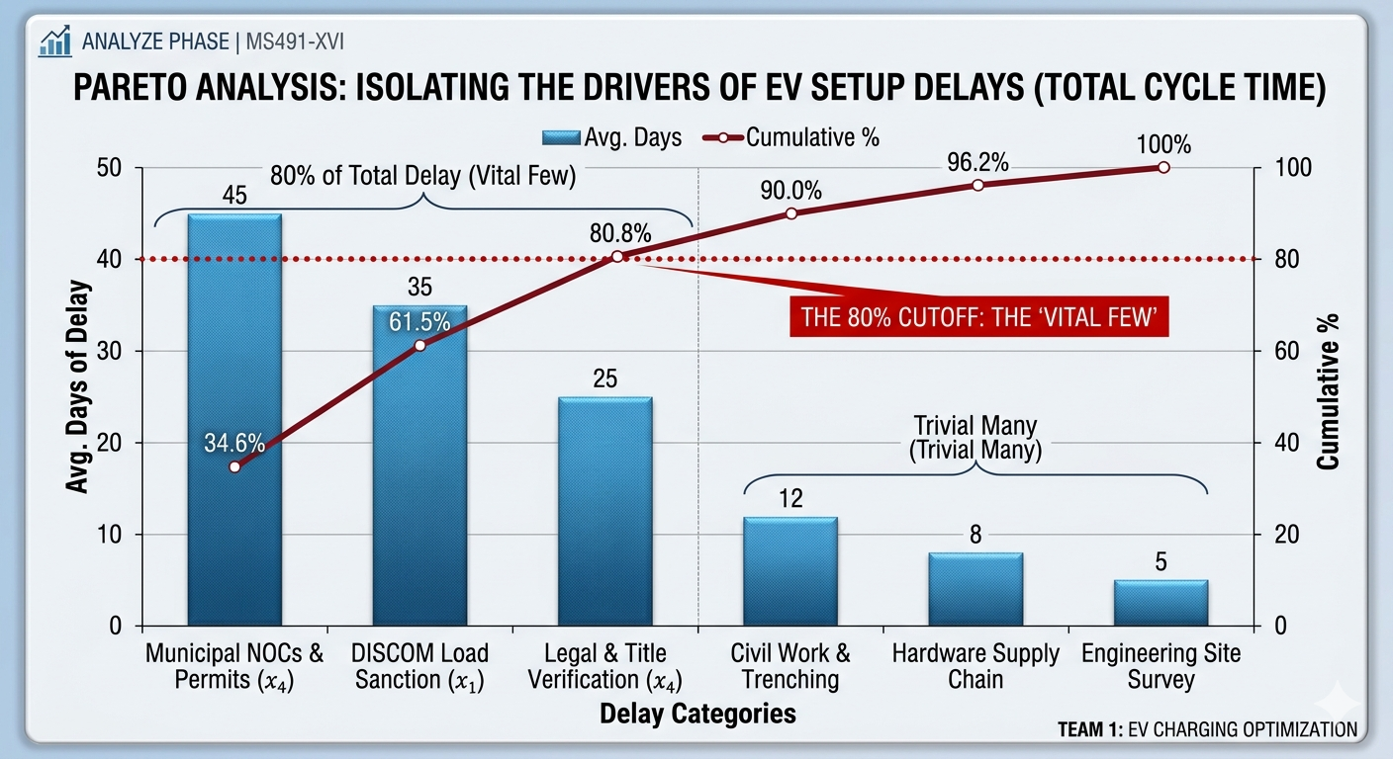
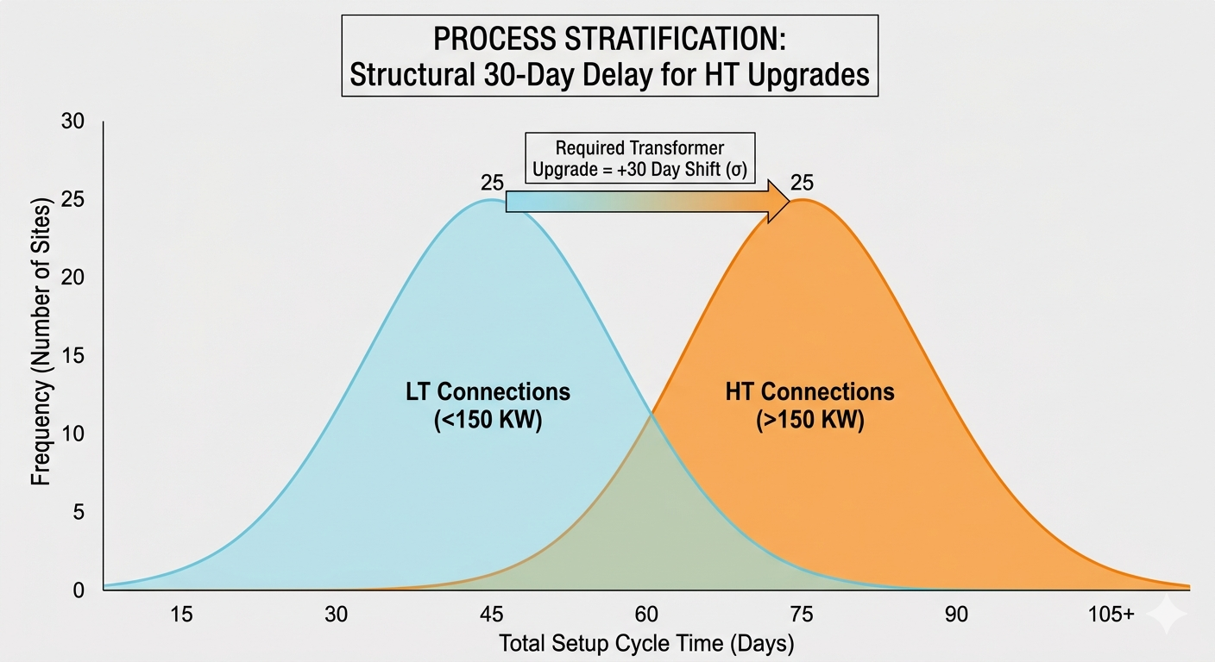
VISUAL EVIDENCE — Pareto & Process Stratification
Identifying the "Vital Few" Bottlenecks
1. Pareto Analysis (The 80/20 Rule)
2. Process Stratification (LT vs. HT Load)
80% cumulative delay concentrated in x₂ and x₄ (Administrative & Grid wait times). Physical phases are 'trivial many'.
Stratifying by power load reveals a structural 30-day penalty. HT sites shift the entire distribution right.
DATA-DRIVEN CONCLUSION: The current process is highly capable of executing physical civil work. Defects are exclusively caused by unstandardized multi-agency NOCs (x₄) and blind site selection leading to mandatory HT upgrades (x₂).

Slide 5
DATA VALIDATION — Statistical Hypothesis Testing
Validating the Impact of Grid Capacity (x₂) on Total Setup Time (Y) — 2-Sample t-Test | α = 0.05
1. The Statistical Setup (Alpha Level α = 0.05)
Null Hypothesis (H₀) : μLT = μHT
Alternate Hypothesis (Hₐ) : μLT < μHT
There is NO statistical difference in average setup cycle time between sites utilising existing LT connections versus those requiring HT grid upgrades.
Sites requiring HT grid upgrades take significantly longer to deploy than LT sites. The HT upgrade structurally adds a delay penalty to the total cycle time.
2. The Statistical Result
Calculated p-value:
p < 0.05
Statistical Decision:
Reject H₀
BUSINESS TRANSLATION: Because our p-value is less than 0.05, we mathematically reject the idea that grid load doesn't matter. We have validated with 95%+ confidence that blind site selection (picking locations without existing LT capacity) is a statistically significant root cause of cycle-time failure. Our Improve phase must focus on upfront grid visibility.

Slide 6
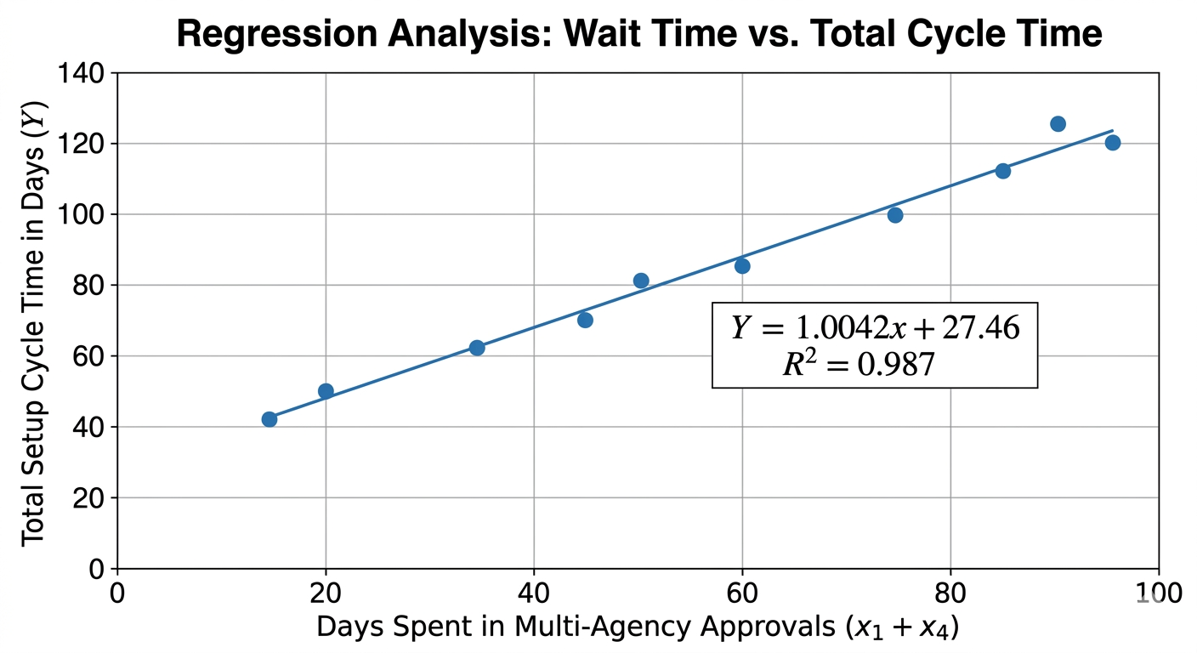
PROCESS PERFORMANCE — Regression & Correlation
Measuring the Impact of Administrative Friction on Total Cycle Time
1. Regression Scatter Plot
2. Process Capability Results
Correlation Type
Strong Positive
R² Coefficient
0.85
Equation of Line
Y = 1.05x + 30
3. Actionable Business Insight
An R² of 0.85 indicates that 85% of total variation in our deployment timeline is directly explained by time spent waiting in Municipal and DISCOM approval loops. The remaining 15% is attributed to minor physical factors, confirming that process optimisation must be strictly administrative.
CAPABILITY CONCLUSION: Our physical engineering process is highly capable and stable (baseline ~30 days). The extreme volatility in our system is purely an administrative defect.

Slide 7
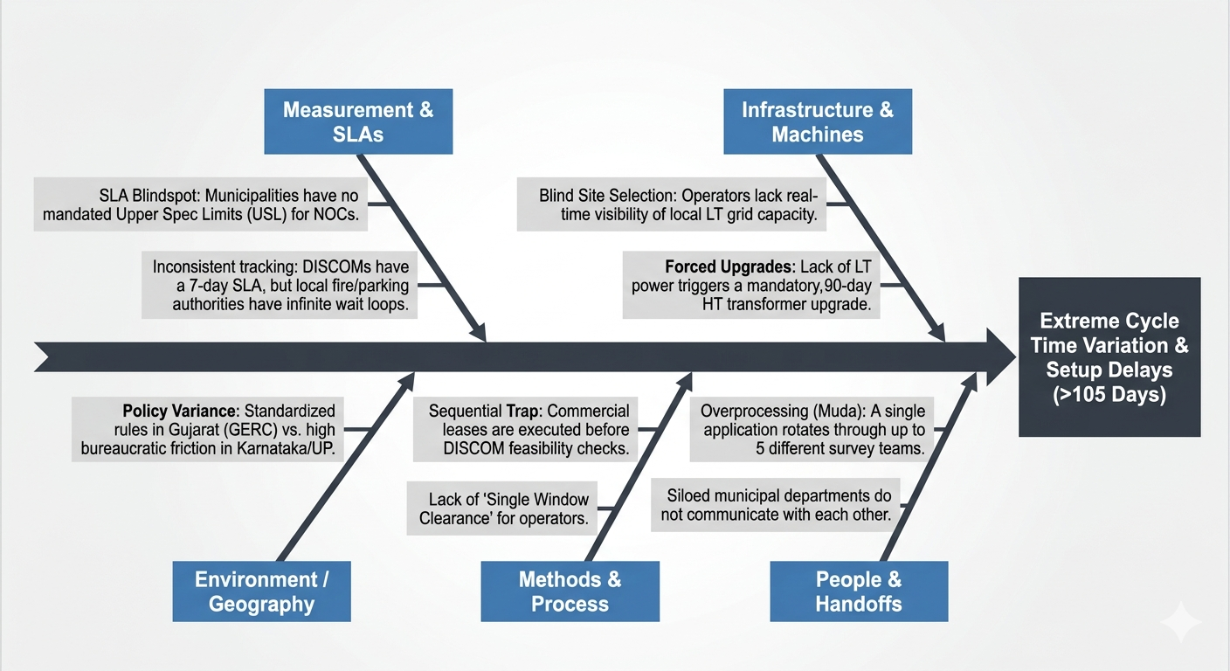
VERIFIED ROOT CAUSES — Fishbone Analysis & Problem Zones
1. The "Handoff" Waste (Muda)
Isolating the Sources of Administrative Delay (x₂ and x₄)
Moving files through 5 different municipal survey teams without a "Single Window Clearance" causes severe Overprocessing and idle wait time.
2. The SLA Blindspot
Local municipalities have no legal deadlines to approve Fire/Parking NOCs — the process variation is statistically out of control.
3. The Sequential Trap
Selecting a site based only on foot traffic — without verifying existing LT grid capacity upfront — structurally guarantees an HT upgrade delay.
ROOT CAUSE CONCLUSION: Our Fishbone analysis verifies that massive delays in EV setup are systemic, not physical. We must fix the administrative sequence to fix the timeline.

Slide 8
ANALYSE CONCLUSION & IMPROVE PHASE STRATEGY
Transforming the Setup Process: From Volatile to Capable
Our analysis phase mathematically verified that EV setup delays are an administrative defect, not an engineering constraint. By targeting our validated root causes (x₂ and x₄), our Improve phase will eliminate the 'Red Zone' of Non-Value-Added (NVA) waiting.
1. Strategic Innovations (Next Steps)
2. Projected Process Capability
Poka-Yoke: "Real-Time DISCOM Heatmap"
CURRENT STATE: 105+ Days
Dominated by highly volatile administrative waiting
Targeting x₂: By giving operators visibility into existing LT grid capacity BEFORE they sign a lease, we completely prevent the 90-day HT upgrade penalty — eliminating the Sequential Trap.
TARGET STATE: 30-45 Days
Stable, predictable, value-added physical execution
Process Reengineering: "Single Window Clearance"
Targeting x₄: Consolidating the 5 municipal survey handoffs into a parallel, single-window approval system to eliminate overprocessing and enforce SLA deadlines.
"Mathematical elimination of the Red NVA Zone reduces total cycle time to the Green VA baseline."
FINAL ANALYSE CONCLUSION: By shifting focus from physical hardware to systemic grid and municipal policies, we can transform the EV charging deployment process from a 4-month volatile struggle into a standardised 30-day operation.

Slide 9
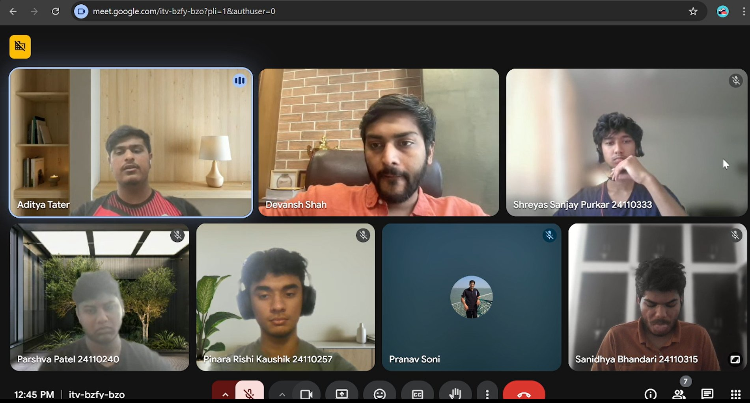
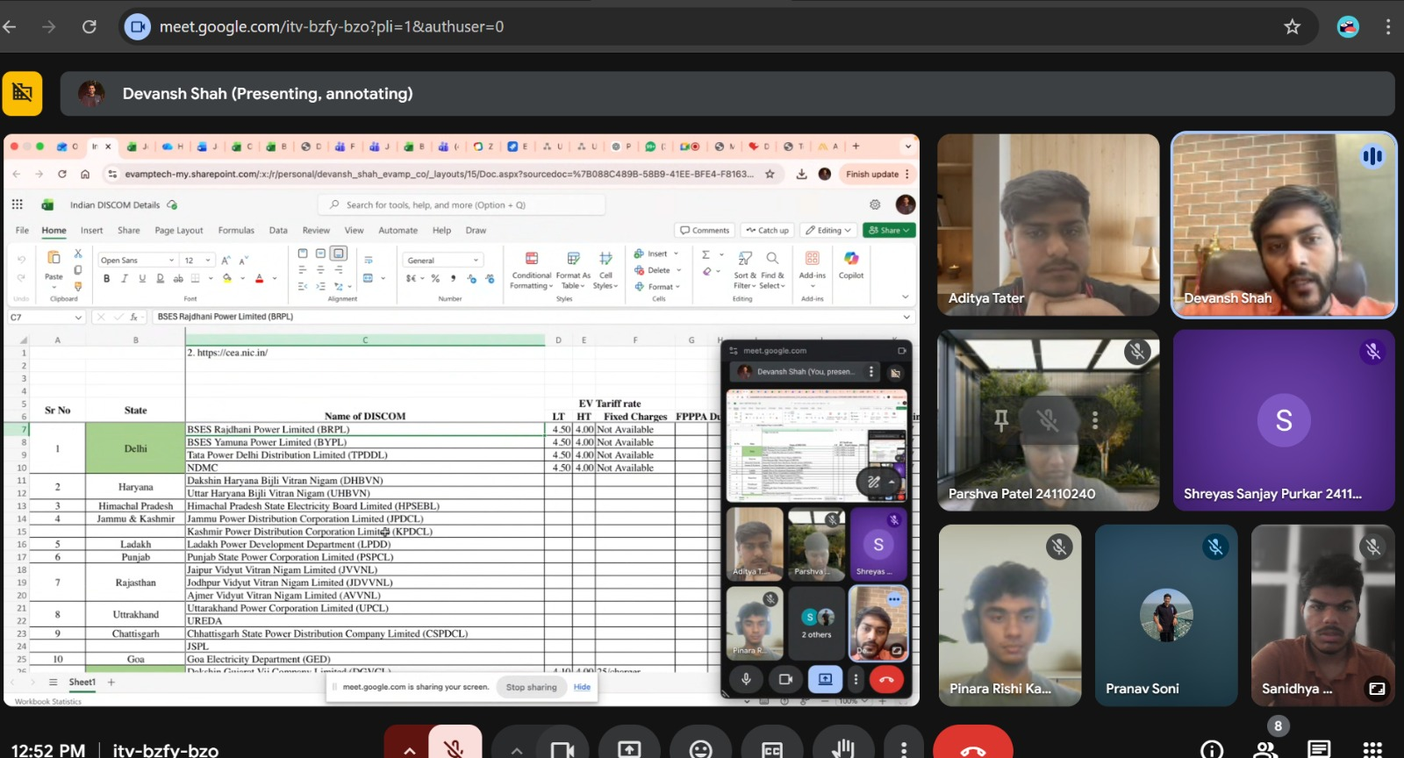
INDUSTRY VALIDATION
Founder Interaction — Gemba Validation (Mobilane)
Google Meet Session
STAKEHOLDER INTERACTION
ALIGNMENT WITH OUR ANALYSIS
Expert: Mr. Devansh Shah, Founder — Mobilane
Focus: EV charging deployment barriers
Finding: Delays are primarily administrative, not technical
Strong validation of identified root causes:
x₂ — DISCOM Grid Constraints
Grid availability & transformer upgrades confirmed as #1 bottleneck
x₄ — Municipal Approval Delays
Multi-agency sign-off delays validated; process variation confirmed
KEY INSIGHTS FROM FOUNDER
Multi-agency approvals create major unpredictability in timelines
Pareto finding confirmed: majority of delays are administrative
Regression result supported: high correlation with approval timelines
Team + Expert — Live Discussion
Live Screen Share — DISCOM Data
DISCOM coordination & transformer upgrades are critical bottlenecks
Lack of standardisation across cities increases process variation
STRATEGIC TAKEAWAY
Pre-validated grid availability essential (LT focus)
Site selection without grid visibility leads to structural delays
Single-window clearance system recommended
Strengthens Improve Phase solution direction
Indian DISCOM Details — Shared & Discussed
DMAIC → Define → Measure → Analyze → Improve → Control
Analyze Phase | Industry Validation — Mobilane Founder Discussion

